Slide 1
Module 3: Agile Software Development
Software Engineering
School of Computing, Faculty of Engineering
Universiti Teknologi Malaysia

Slide 2
Outline
Agile methods
Agile development techniques
Agile project management
Scaling agile methods
Note: The overall contents of the slide are based on the main reference that is Sommerville (2016) with other references specified directly in respective slides

Slide 3
Objectives
The objectives of this module are:
To understand the rationale for agile software development methods, its manifesto, and the differences between agile and plan-driven development
To recognise the importance of agile development techniques and practices
To understand the Scrum approach in agile project management
To be aware of the issues of scaling agile development methods

Slide 4
AGILE METHODS

Slide 5
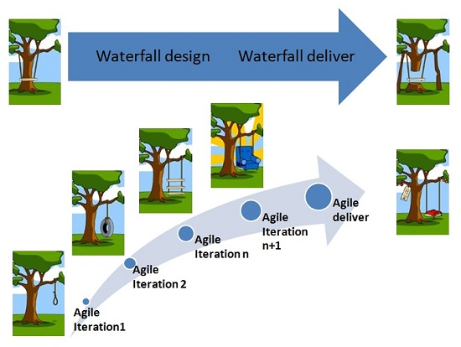
Introduction

Slide 6
Rapid Software Development
Rapid development and delivery is now often the most important requirement for software systems:
Businesses operate in a fast-changing requirement and it is practically impossible to produce a set of stable software requirements
Software has to evolve quickly to reflect changing business needs
Plan-driven development is essential for some types of system but does not meet these business needs
Agile development methods emerged in the late 1990s whose aim was to radically reduce the delivery time for working software systems

Slide 7
Agile Development
Program specification, design and implementation are inter-leaved
The system is developed as a series of versions or increments with stakeholders involved in version specification and evaluation
Frequent delivery of new versions for evaluation
Extensive tool support (e.g. automated testing tools) used to support development
Minimal documentation – focus on working code

Slide 8
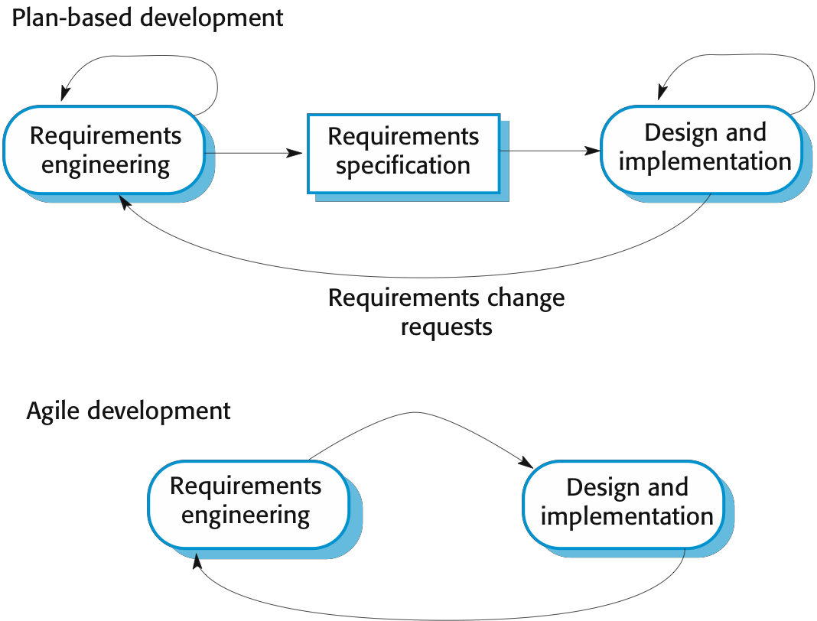
Plan-Driven and Agile Development…

Slide 9
Plan-Driven and Agile Development
Plan-driven development
A plan-driven approach to software engineering is based around separate development stages with the outputs to be produced at each of these stages planned in advance
Not necessarily waterfall model – plan-driven, incremental development is possible
Iteration occurs within activities
Agile development
Deliver ideally 2-3 weeks
Specification, design, implementation and testing are inter-leaved and the outputs from the development process are decided through a process of negotiation during the software development process

Slide 10
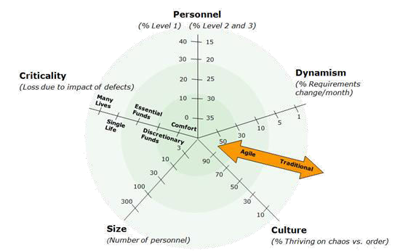
Balance of Plan-Driven or Agile Development…
Source: Boehm, Barry, and Richard Turner. Balancing Agility and Discipline: A Guide for the Perplexed. 1st ed. Addison-Wesley/Pearson Education, 2003.
How should I decide to use agile in my project?

Slide 11
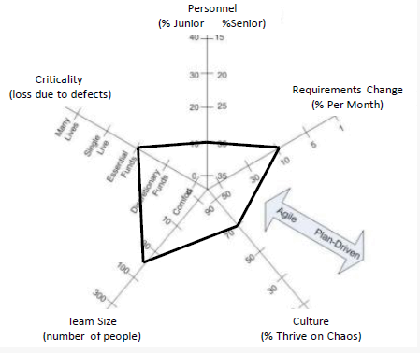
Balance of Plan-Driven or Agile Development
Source:. Boehm, Barry, and Richard Turner. Balancing Agility and Discipline: A Guide for the Perplexed. 1st ed. Addison-Wesley/Pearson Education, 2003.

Slide 12
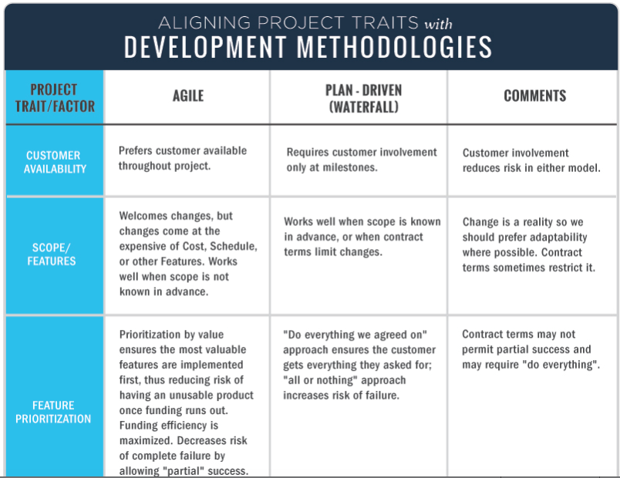
Plan-Driven and Agile…

Slide 13
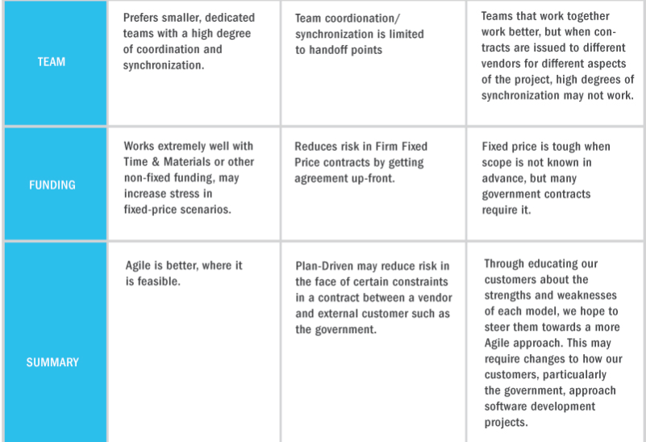
Plan-Driven and Agile

Slide 14
Agile Methods
Dissatisfaction with the overheads involved in software design methods of the 1980s and 1990s led to the creation of agile methods that:
Focus on the code rather than the design
Are based on an iterative approach to software development
Are intended to deliver working software quickly and evolve this quickly to meet changing requirements
The aim of agile methods is to reduce overheads in the software process (e.g. by limiting documentation) and to be able to respond quickly to changing requirements without excessive rework

Slide 15

Agile Manifesto
Source: http://agilemanifesto.org
The philosophy emphasizes flexibility and producing software quickly and capably.
“We are uncovering better ways of developing software by doing it and helping others do it. Through this work we have come to value:
Individuals and interactions over processes and tools
Working software over comprehensive documentation
Customer collaboration over contract negotiation
Responding to change over following a plan
That is, while there is value in the items on the right, we
value the items on the left more.”

Slide 16
The Principles of Agile Methods
Principle | Description
Customer involvement | Customers should be closely involved throughout the development process. Their role is to provide and prioritize new system requirements, select the features to be included in each successive build and to evaluate the iterations of the system.
Incremental delivery | The software is developed in increments with the customer specifying the requirements to be included in each increment.
People not process | The skills of the development team should be recognized and exploited. Team members should be left to develop their own ways of working without prescriptive processes.
Embrace change | Expect the system requirements to change and so design the system to accommodate these changes.
Maintain simplicity | Focus on simplicity in both the software being developed and in the development process. Wherever possible, actively work to eliminate complexity from the system.

Slide 17
Agile Methods Applicability
Product development where a software company is developing a small or medium-sized product for sale
Virtually all software products and apps are now developed using an agile approach
Custom system development within an organization, where:
there is a clear commitment from the customer to become involved in the development process
there are few external rules and regulations that affect the software

Slide 18
AGILE DEVELOPMENT TECHNIQUES

Slide 19
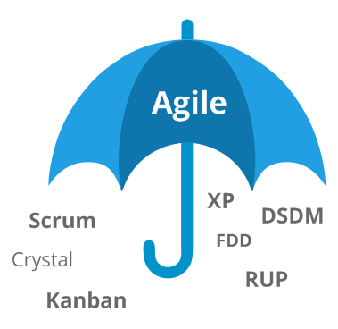
Agile Development Techniques

Slide 20
Extreme Programming
A very influential agile method, developed in the late 1990s, that introduced a range of agile development techniques
Extreme Programming (XP) takes an ‘extreme’ approach to iterative development:
New versions may be built several times per day
Increments are delivered to customers every 2 weeks
All tests must be run for every build and the build is only accepted if tests run successfully

Slide 21

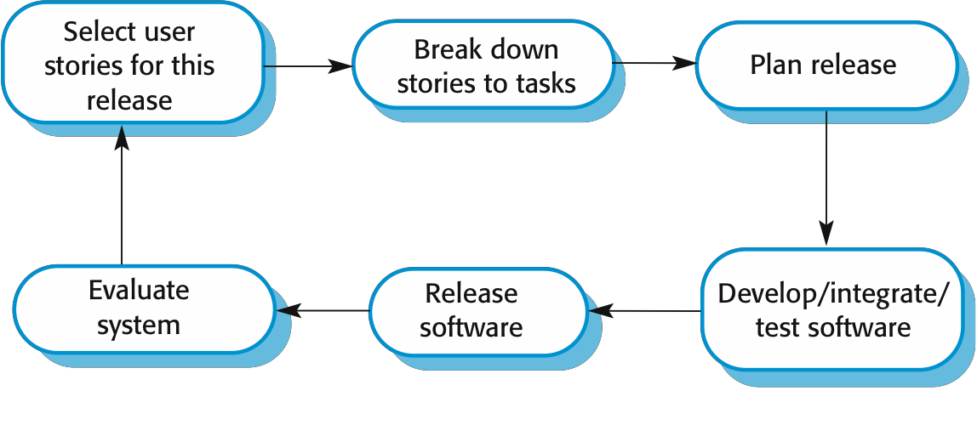
The Extreme Programming Release Cycle
Requirements & Analysis
Time & cost estimates are given to the
customer

Slide 22
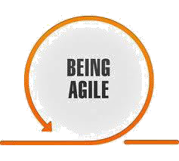




XP and Agile Principles
Incremental development is supported through small, frequent system releases
Customer involvement means full-time customer engagement with the team
People not process through pair programming, collective ownership and a process that avoids long working hours
Change supported through regular system releases
Maintaining simplicity through constant refactoring of code
iteration
people
NOT
process
customer
small
code quality
frequent releases
support change
© valtech.com

Slide 23
Influential XP Practices
Extreme programming has a technical focus and is not easy to integrate with management practice in most organizations
Consequently, while agile development uses practices from XP, the method as originally defined is not widely used
Key practices:
User stories for specification
Refactoring
Test-first development
Pair programming

Slide 24
1: User stories for specifications
User stories describe a feature from the user perspective
In XP, a customer (or user) is part of the XP team and is responsible for making decisions on requirements
User requirements are expressed as scenarios or user stories
These are written on cards and the development team break them down into implementation tasks as the basis of schedule and cost estimates
The customer chooses the stories for inclusion in the next release based on their priorities and the schedule estimates

Slide 25

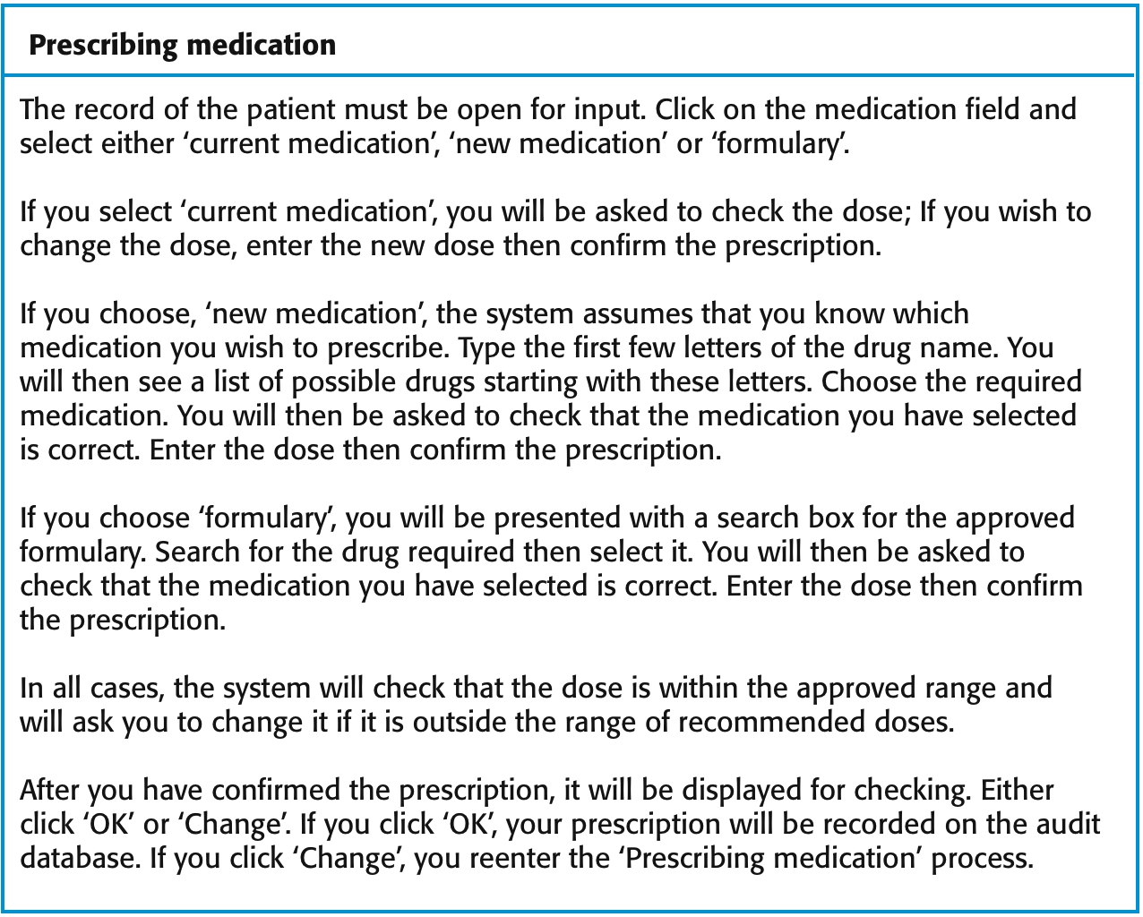





Example: ‘prescribing medication’ Story
User type –
A
doctor
prescribing medication for a patient
Who wants to benefit from this requirement
Field options
Functionality
– Outlines what the software should do

Slide 26
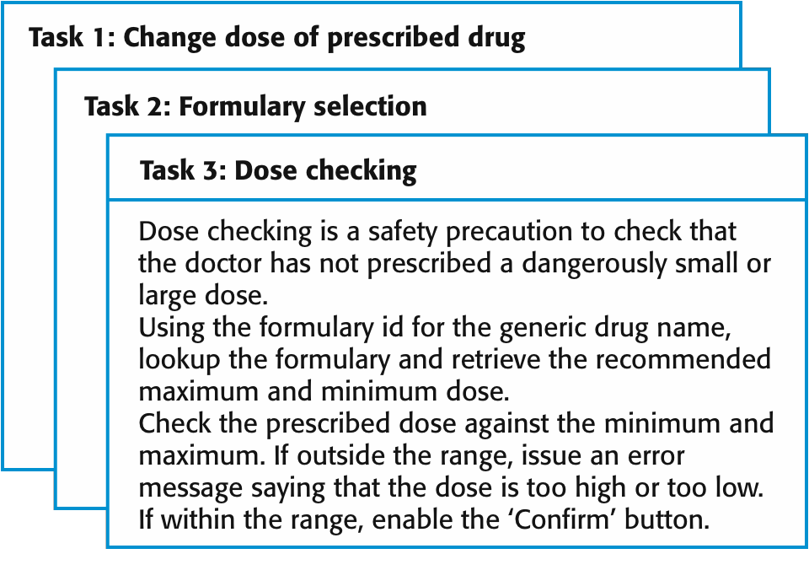






Example: Task cards for prescribing medication
Prioritization
Effort and resource estimation for implementing each task

Slide 27
2: Refactoring…
Conventional wisdom in software engineering is to design for change
It is worth spending time and effort anticipating changes as this reduces costs later in the life cycle
XP, however, maintains that this is not worthwhile as changes cannot be reliably anticipated
Rather, it proposes constant code improvement (refactoring) to make changes easier when they have to be implemented

Slide 28
2: Refactoring
Programming team looks for possible software improvements and make these improvements even where there is no immediate need for them
This practice improves the understandability of the software, thus reduces the need for documentation
Changes are easier to make because the code is well-structured and clear
However, some changes require architecture refactoring and this is much more expensive

Slide 29
Example of Refactoring
Re-organization of a class hierarchy to remove duplicate code
Tidying up and renaming attributes and methods to make them easier to understand
The replacement of inline code with calls to methods that have been included in a program library

Slide 30
3: Test-First Development
Testing is central to XP and XP has developed an approach where the program is tested after every change has been made
XP testing features:
Test-first development
Incremental test development from scenarios
User involvement in test development and validation
Automated test harnesses are used to run all component tests each time that a new release is built

Slide 31
4: Pair Programming…
Pair programming involves programmers working in pairs, developing code together
This helps develop common ownership of code and spreads knowledge across the team
It serves as an informal review process as each line of code is looked at by more than 1 person
It encourages refactoring as the whole team can benefit from improving the system code

Slide 32
4: Pair Programming
In pair programming, programmers sit together at the same computer to develop the software
Pairs are created dynamically so that all team members work with each other during the development process
The sharing of knowledge that happens during pair programming is very important as it reduces the overall risks to a project when team members leave
Pair programming is not necessarily inefficient and there is some evidence that suggests that a pair working together is more efficient than 2 programmers working separately

Slide 33
AGILE PROJECT MANAGEMENT

Slide 34
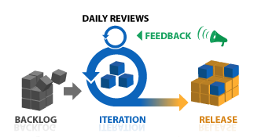
Agile Project Management
The principal responsibility of software project managers is to manage the project so that the software is delivered on time and within the planned budget for the project
The standard approach to project management is plan- driven
Managers draw up a plan for the project showing what should be delivered, when it should be delivered and who will work on the development of the project deliverables
Agile project management requires a different approach, which is adapted to incremental development and the practices used in agile methods
© http://www.planbox.com/resources/agile-
project-management

Slide 35
Scrum
Scrum is an agile method that focuses on managing iterative development rather than specific agile practices
There are three phases in Scrum:
The initial phase is an outline planning phase where the team establishes the general objectives for the project and design the software architecture
This is followed by a series of sprint cycles, where each cycle develops an increment of the system
The project closure phase wraps up the project, completes required documentation such as system help frames and user manuals and assesses the lessons learned from the project

Slide 36
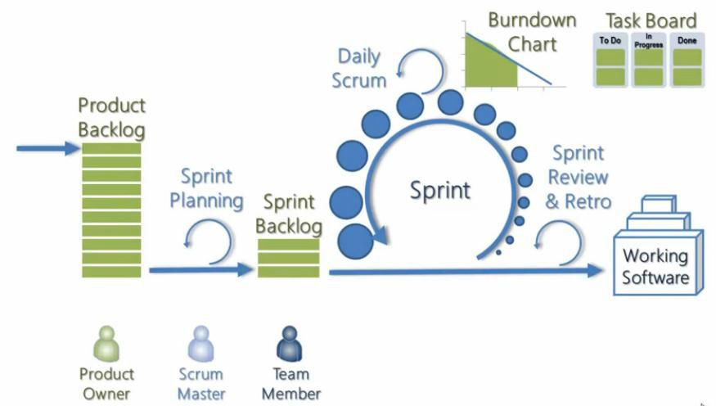
The Scrum Process

Slide 37
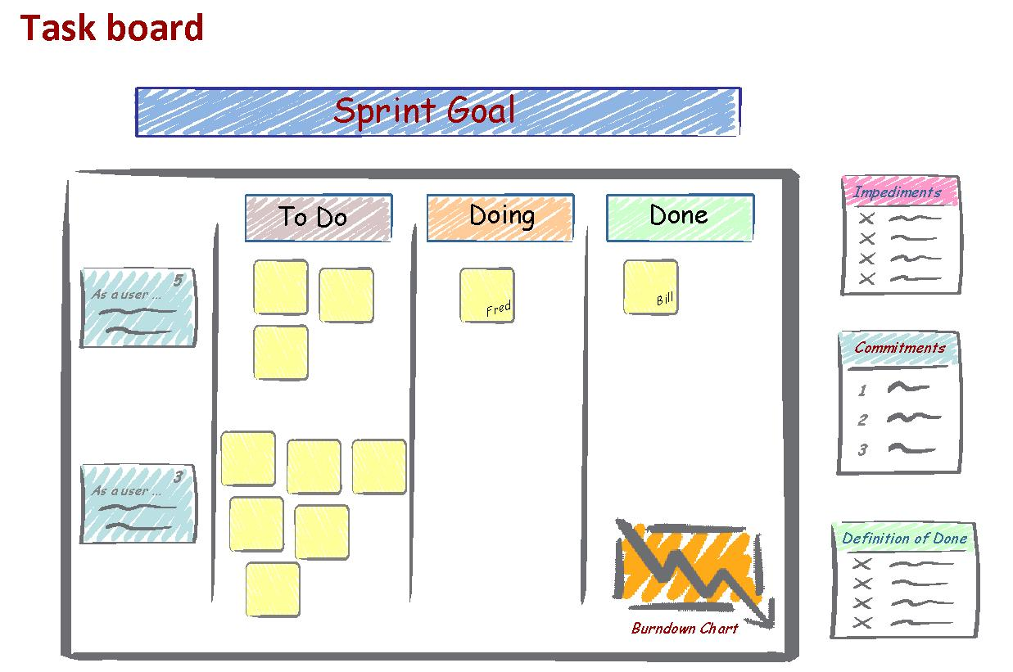
Task Board

Slide 38
The Scrum Sprint Cycle
Sprints are fixed length, normally 2–4 weeks
The starting point for planning is the product backlog, which is the list of work to be done on the project
The selection phase involves all the project team members who work with the customer to select the features and functionality from the product backlog to be developed during the sprint

Slide 39
The Sprint Cycle
Once these are agreed, the team organize themselves to develop the software
During this stage the team is isolated from the customer and the organization, with all communications channelled through the so-called ‘Scrum master’
The role of the Scrum master is to protect the development team from external distractions
At the end of the sprint, the work done is reviewed and presented to stakeholders
The next sprint cycle then begins

Slide 40

Teamwork in Scrum
The ‘Scrum master’ is a facilitator who arranges daily meetings, tracks the backlog of work to be done, records decisions, measures progress against the backlog and communicates with customers and management outside of the team
The whole team attends short daily meetings (Scrums) where all team members share information, describe their progress since the last meeting, problems that have arisen and what is planned for the following day
This means that everyone on the team knows what is going on and, if problems arise, can re-plan short-term work to cope with them

Slide 41
Scrum Benefits
The product is broken down into a set of manageable and understandable chunks
Unstable requirements do not hold up progress
The whole team have visibility of everything and consequently team communication is improved
Customers see on-time delivery of increments and gain feedback on how the product works
Trust between customers and developers is established and a positive culture is created in which everyone expects the project to succeed

Slide 42
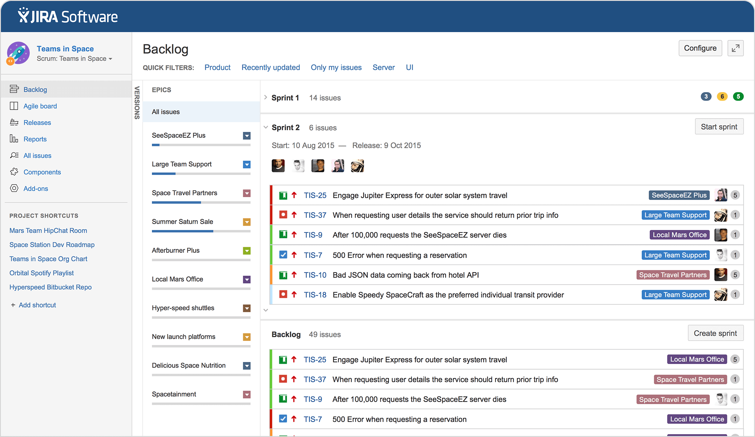
Example of Agile Project Management: JIRA Software

Slide 43
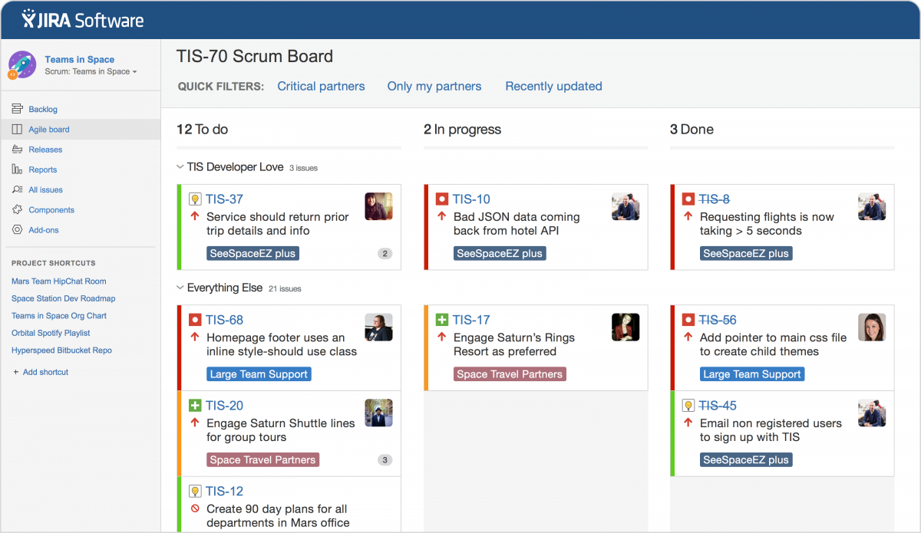
Example of Agile Project Management: JIRA Software

Slide 44
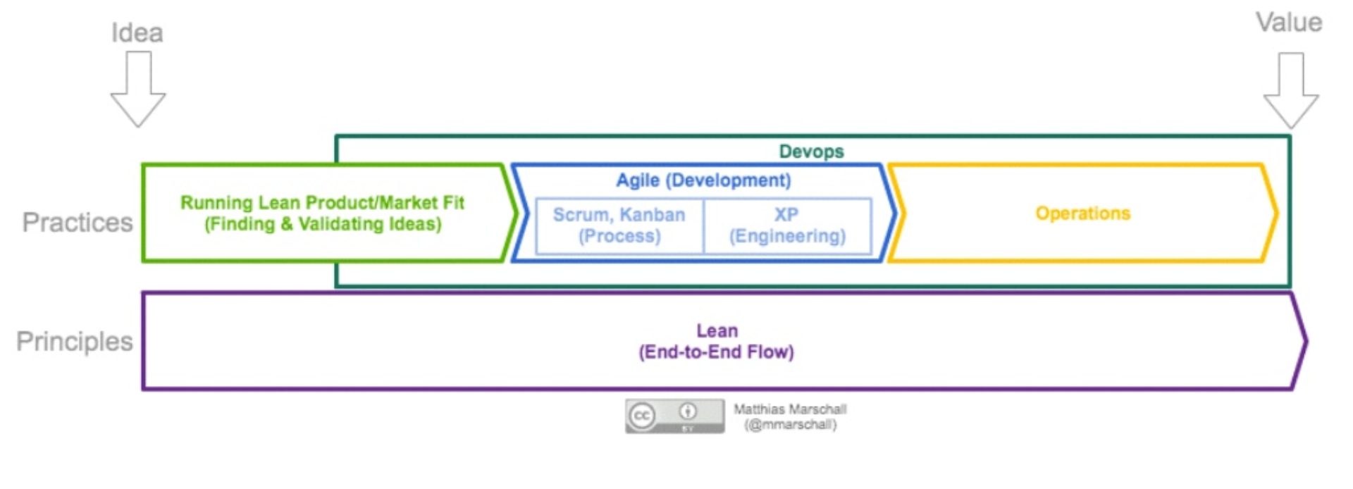
DevOps: Agile & Lean to Operations Work
DevOps: a practice of operations and developments engineers participating together in the entire service lifecycle from design through development process to production support
Source: https://theagileadmin.com/what-is-devops/

Slide 45
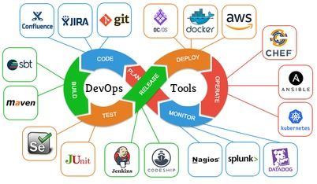
DevOps and Tools
DevOps is a set of practices that emphasizes the collaboration and communication of both software developers and other information technology (IT) professionals, while automating the process of software delivery and infrastructure changes, its implementation can include the definition of the series of tools used at various stages of the lifecycle
There is no one product that can be considered a single DevOps tool
Source: https://dzone.com/articles/an-agile-introduction-to-devops-what-is-devops-any

Slide 46
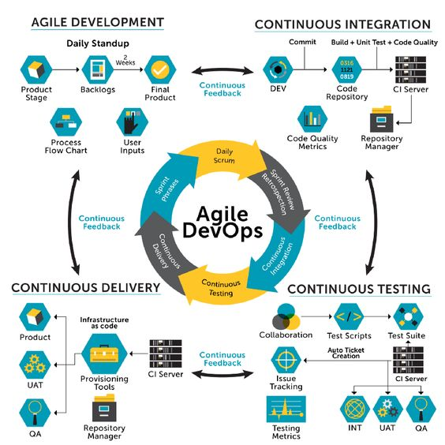
Agile DevOps…
Agile along with DevOps has a collaborative working style, irrespective of the method implemented
Both the methodologies rely on continual feedback and routine updates about the work progress from internal and external stakeholders
Both Agile and DevOps focus on developing the product at a fast pace, by keeping smaller teams and using a risk-free approach
Both methods adapt to the business requirements and continually improve the products to fulfill customer expectations
https://www.educba.com/agile-devops/

Slide 47
Agile DevOps
Agile DevOps is an extended agile methodology for product development where DevOps is a succession to agile and not a replacement
In a nutshell, Agile works towards software development by making continuous alterations, adapting and developing products as per customer expectations
While DevOps through automated processes and bug detection at an early stage of software development focusses primarily on deploying products of high quality
Source: https://www.educba.com/agile-devops/

Slide 48
SCALING AGILE METHODS

Slide 49
Practical Problems with Agile Methods
The informality of agile development is incompatible with the legal approach to contract definition that is commonly used in large companies
Agile methods are most appropriate for new software development rather than software maintenance
Yet the majority of software costs in large companies come from maintaining their existing software systems
Agile methods are designed for small co-located teams yet much software development now involves worldwide distributed teams

Slide 50
Scaling Agile Methods
Agile methods have proved to be successful for small and medium sized projects that can be developed by a small co-located team
However, the usage of Agile methodologies in large corporations has been growing steadily over the past decade. Here are some statistics based on various surveys and reports:
According to the 15th Annual State of Agile Report by VersionOne, 97% of respondents indicated that their organization is practicing Agile development methods, up from 84% in 2015
A survey by Agile Alliance found that 79% of respondents reported using Agile methodologies in large organizations, up from 64% in 2015

Slide 51
Scaling Agile Methods
A report by McKinsey & Company found that 94% of respondents reported that their organizations had adopted Agile methods, and 76% reported that they had successfully scaled Agile beyond a single team
According to a survey by Deloitte, 68% of respondents reported that their organization had adopted Agile methodologies, up from 42% in 2016
The 2020 State of Agile Marketing Report found that 63% of respondents reported using Agile methodologies in large organizations, up from 50% in 2019

Slide 52
Scaling Agile Methods
It is sometimes argued that the success of these methods comes because of improved communications which is possible when everyone is working together
Scaling up agile methods involves changing these to cope with larger, longer projects where there are multiple development teams, perhaps working in different locations

Slide 53
Large Systems Development…
Large systems are usually collections of separate communicating systems, where separate teams develop each system. Frequently, these teams are working in different places, sometimes in different time zones.
Large systems are ‘brownfield systems’, that is they include and interact with a number of existing systems. Many of the system requirements are concerned with this interaction and so don’t really lend themselves to flexibility and incremental development.
Where several systems are integrated to create a system, a significant fraction of the development is concerned with system configuration rather than original code development.

Slide 54
Large System Development
Large systems and their development processes are often constrained by external rules and regulations limiting the way that they can be developed.
Large systems have a long procurement and development time. It is difficult to maintain coherent teams who know about the system over that period as, inevitably, people move on to other jobs and projects.
Large systems usually have a diverse set of stakeholders. It is practically impossible to involve all of these different stakeholders in the development process.

Slide 55
Scaling Out and Scaling Up
‘Scaling up’ is concerned with using agile methods for developing large software systems that cannot be developed by a small team.
‘Scaling out’ is concerned with how agile methods can be introduced across a large organization with many years of software development experience.
When scaling agile methods, it is essential to maintain agile fundamentals: Flexible planning, frequent system releases, continuous integration, test-driven development and good team communications.

Slide 56
Scaling Up to Large Systems
For large systems development, it is not possible to focus only on the code of the system. You need to do more up-front design and system documentation.
Cross-team communication mechanisms have to be designed and used. This should involve regular phone and video conferences between team members and frequent, short electronic meetings where teams update each other on progress.
Continuous integration, where the whole system is built every time any developer checks in a change, is practically impossible. However, it is essential to maintain frequent system builds and regular releases of the system.

Slide 57
Scaling Out to Large Companies
Project managers who do not have experience of agile methods may be reluctant to accept the risk of a new approach.
Large organizations often have quality procedures and standards that all projects are expected to follow and, because of their bureaucratic nature, these are likely to be incompatible with agile methods.
Agile methods seem to work best when team members have a relatively high skill level. However, within large organizations, there are likely to be a wide range of skills and abilities.
There may be cultural resistance to agile methods, especially in those organizations that have a long history of using conventional systems engineering processes.

Slide 58
Agile Methods and Software Maintenance
Most organizations spend more on maintaining existing software than they do on new software development. So, if agile methods are to be successful, they have to support maintenance as well as original development.
Two key issues:
Are systems that are developed using an agile approach maintainable, given the emphasis in the development process of minimizing formal documentation?
Can agile methods be used effectively for evolving a system in response to customer change requests?
Problems may arise if original development team cannot be maintained.

Slide 59
Agile Maintenance
Key problems are:
Lack of product documentation
Keeping customers involved in the development process
Maintaining the continuity of the development team
Agile development relies on the development team knowing and understanding what has to be done
For long-lifetime systems, this is a real problem as the original developers will not always work on the system

Slide 60
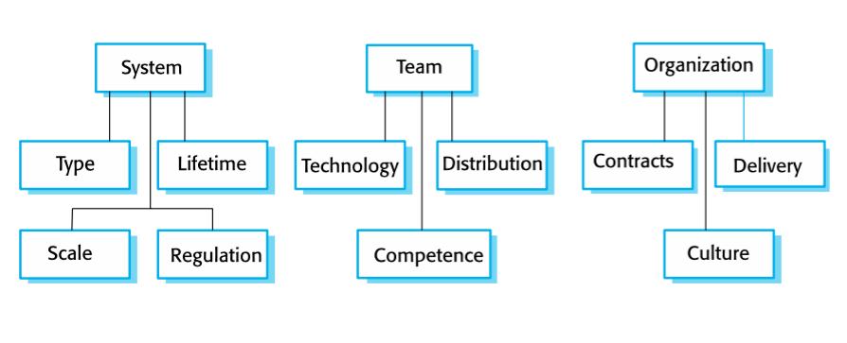
Agile and Plan-Based Factors

Slide 61
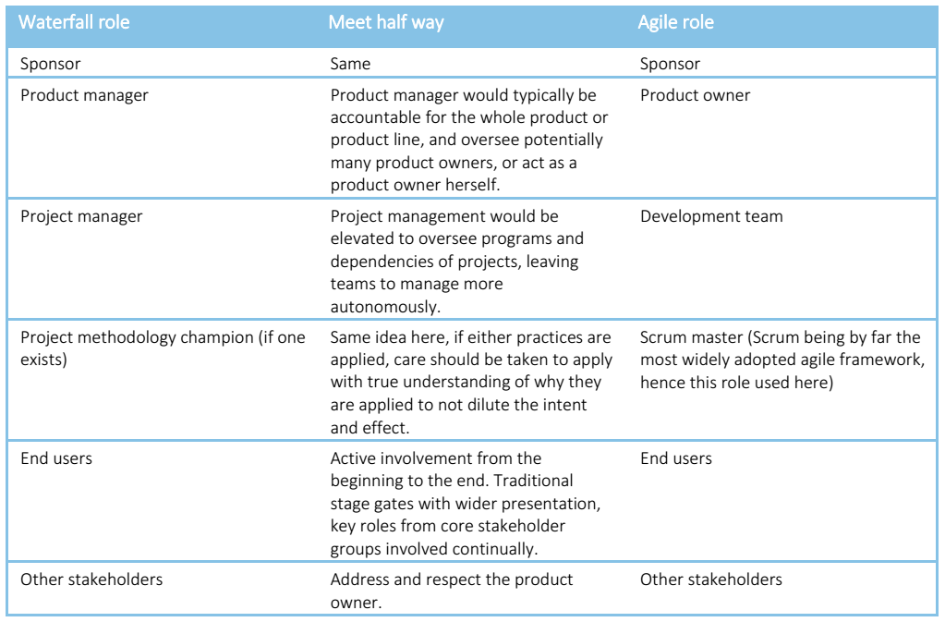
Agile and Waterfall: AgiFall
How to make Agile and Waterfall work together?
Source: https://www.itforbusiness.org/content/uploads/2016/01/Reconcile-Waterfall-and-Agile-for-Long-Term-Best-Results.pdf

Slide 62
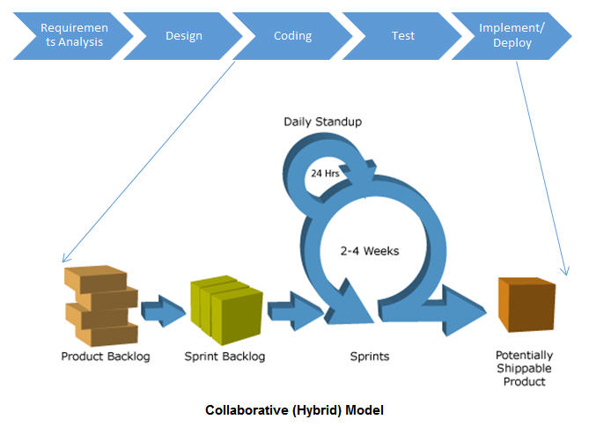
Agile-Waterfall Hybrid
Source: http://www.softwaretestinghelp.com

Slide 63
DSDM
DSDM (Dynamic Systems Development Method) which is specifically designed for large and complex software development projects.
Here are some ways in which DSDM is suitable for large system development:
Incremental development: emphasizes incremental development, which means that the project is broken down into smaller, manageable chunks that are developed and tested in iterations
Timeboxing: uses timeboxing to manage the project schedule. It involves setting fixed deadlines for each iteration, which helps to ensure that the project stays on track and that deliverables are produced on time.
Emphasis on collaboration: emphasizes collaboration between stakeholders, including the development team, the project sponsor, and end-users to ensure that the requirements are well-understood and meets the needs of the stakeholders.
Flexible approach: flexible and can be tailored to the specific needs of the project. This is important in large system development, where the requirements and scope can change rapidly
Focus on quality: emphasizes the importance of quality throughout the development process to ensure that the product meets the required quality standards

Slide 64
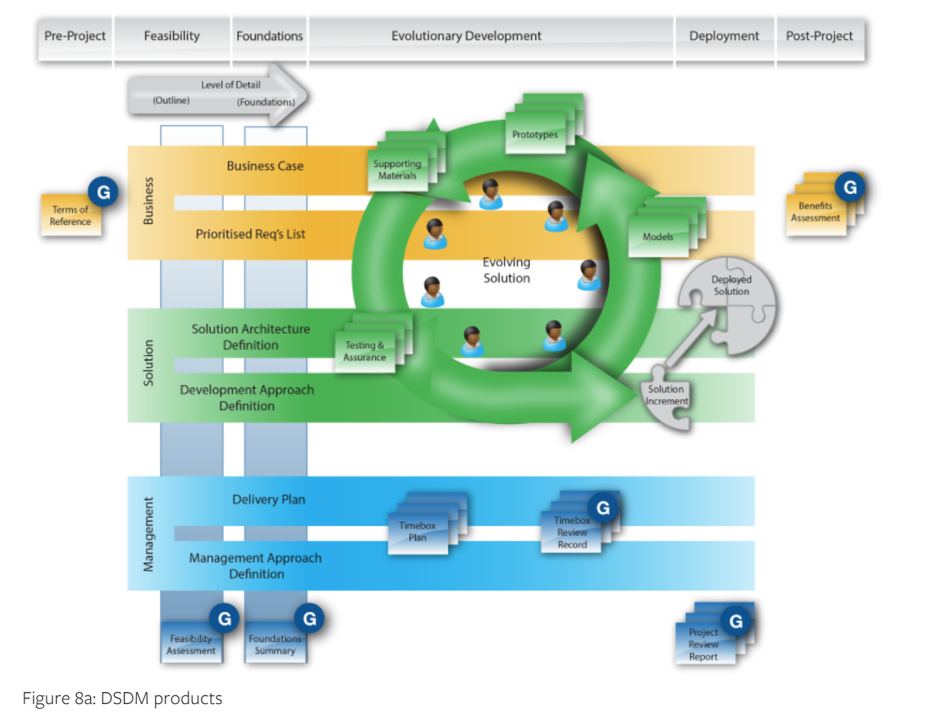
DSDM
Source: http://www.softwaretestinghelp.com

Slide 65
Key points
Agile methods are incremental development methods that focus on rapid software development, frequent releases of the software, reducing process overheads by minimizing documentation and producing high-quality code
Agile development practices include:
User stories for system specification
Frequent releases of the software
Continuous software improvement
Test-first development
Customer participation in the development team

Slide 66
Key points
Scrum is an agile method that provides a project management framework
It is centered round a set of sprints, which are fixed time periods when a system increment is developed
Many practical development methods are a mixture of plan-based and agile development
Scaling agile methods for large systems is difficult
Large systems need up-front design and some documentation and organizational practice may conflict with the informality of agile approaches

